Slide 1


Presenter – Jitendra Singh Tomar

Slide 2
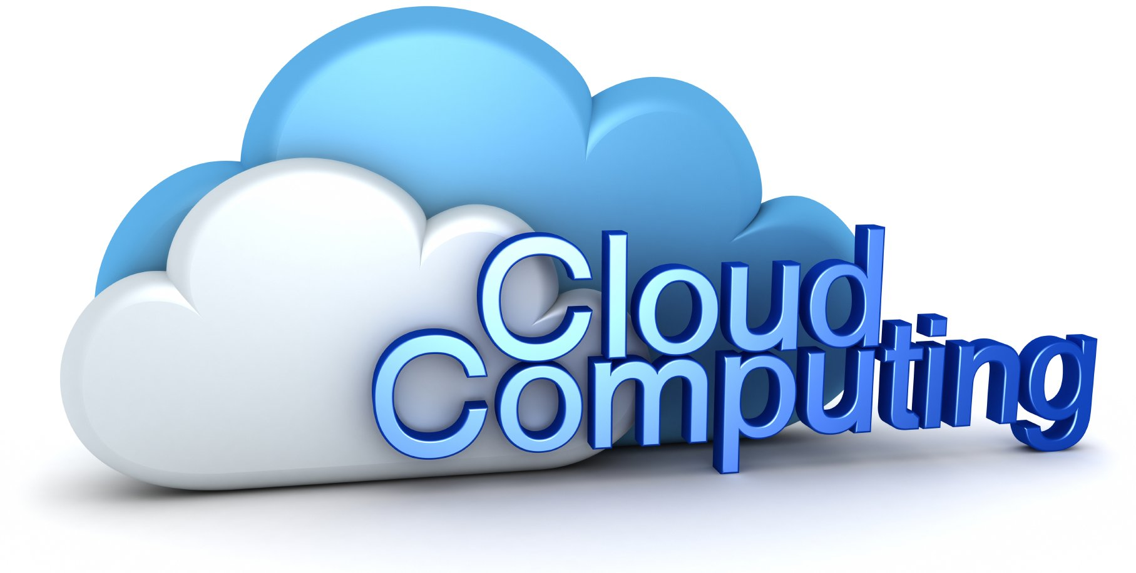
Today’s Agenda
Introduction to Cloud Computing
Why Cloud Computing is a better option?
How does Cloud Computing works?
Services provided by Cloud.
Cloud computing model – What’s best?
Cloud vendors in market.
What is Microsoft Azure?
Global foot print of Azure.

Slide 3
Introduction to Cloud Computing
Cloud computing can be called a technology through which things like software, processing, and data storage are outsourced.
There is only a need for an internet connection, an updated web browser and a compatible device for using a cloud computing service.
Cloud computing makes computer system resources, especially storage and computing power, available on demand without direct active management by the user. [By Wikipedia]

Slide 4
Cloud Computing
Cloud computing is a model for enabling ubiquitous, convenient, on-demand network access to a shared pool of configurable computing resources (e.g., networks, servers, storage, applications, and services) that can be rapidly provisioned and released with minimal management effort or service provider interaction. [By NIST]

Slide 5
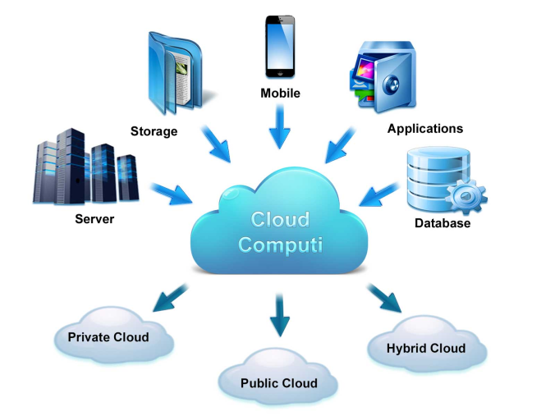
Cloud Computing
Central data center for providing services.
On-demand, scalable, unlimited computation & storage.
It's basically a data center.
4 characteristics of a Cloud:
Everything is a Service (backup, firewall, network…)
Elasticity in nature
HA – 99.99% SLA
Unlimited computation power.
Any Data Center that provides above 4 characteristics is a cloud.

Slide 6
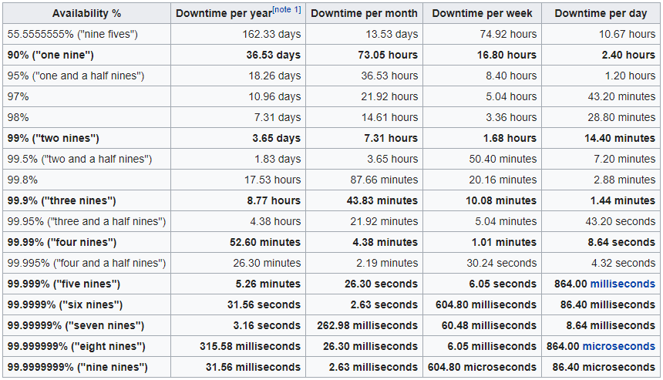
High availability

Slide 7
On-Premises DC
Power supply
Network devices
Storage devices
Server racks
Space
Scalable options
Administrators for Servers, Networks, etc..

Slide 8
Virtualized DC
Achieved using tool called “Hypervisor”.
Advantages of using virtualization:
No maximum limit for a VM.
Centralized monitoring.
Software defined.
There are different types of Virtualization”
Hardware virtualization
Network virtualization
Desktop virtualization
Storage virtualization

Slide 9
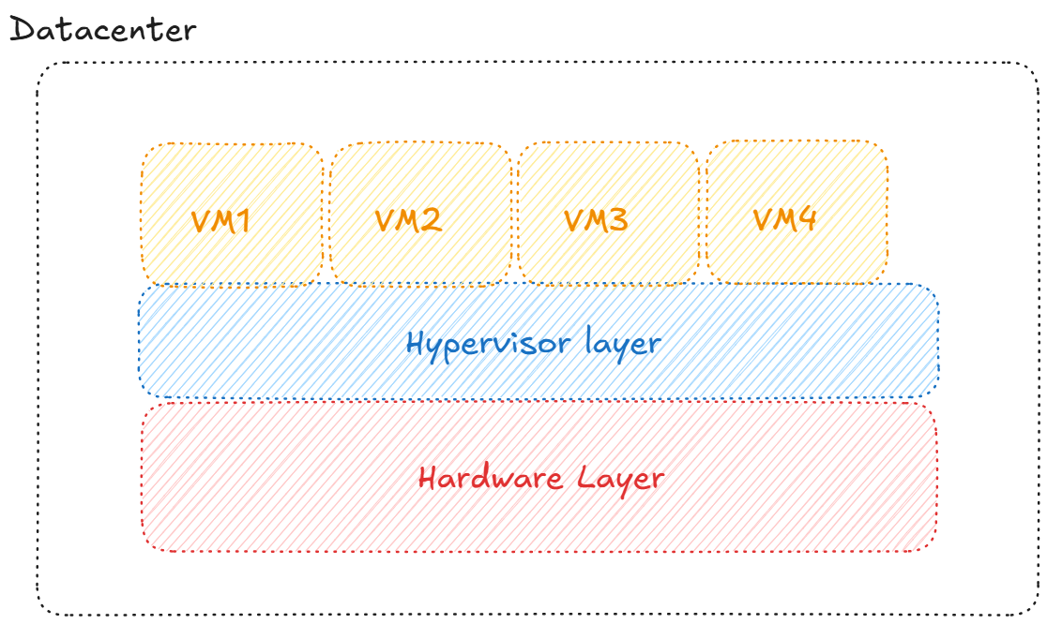
Virtualized DC

Slide 10

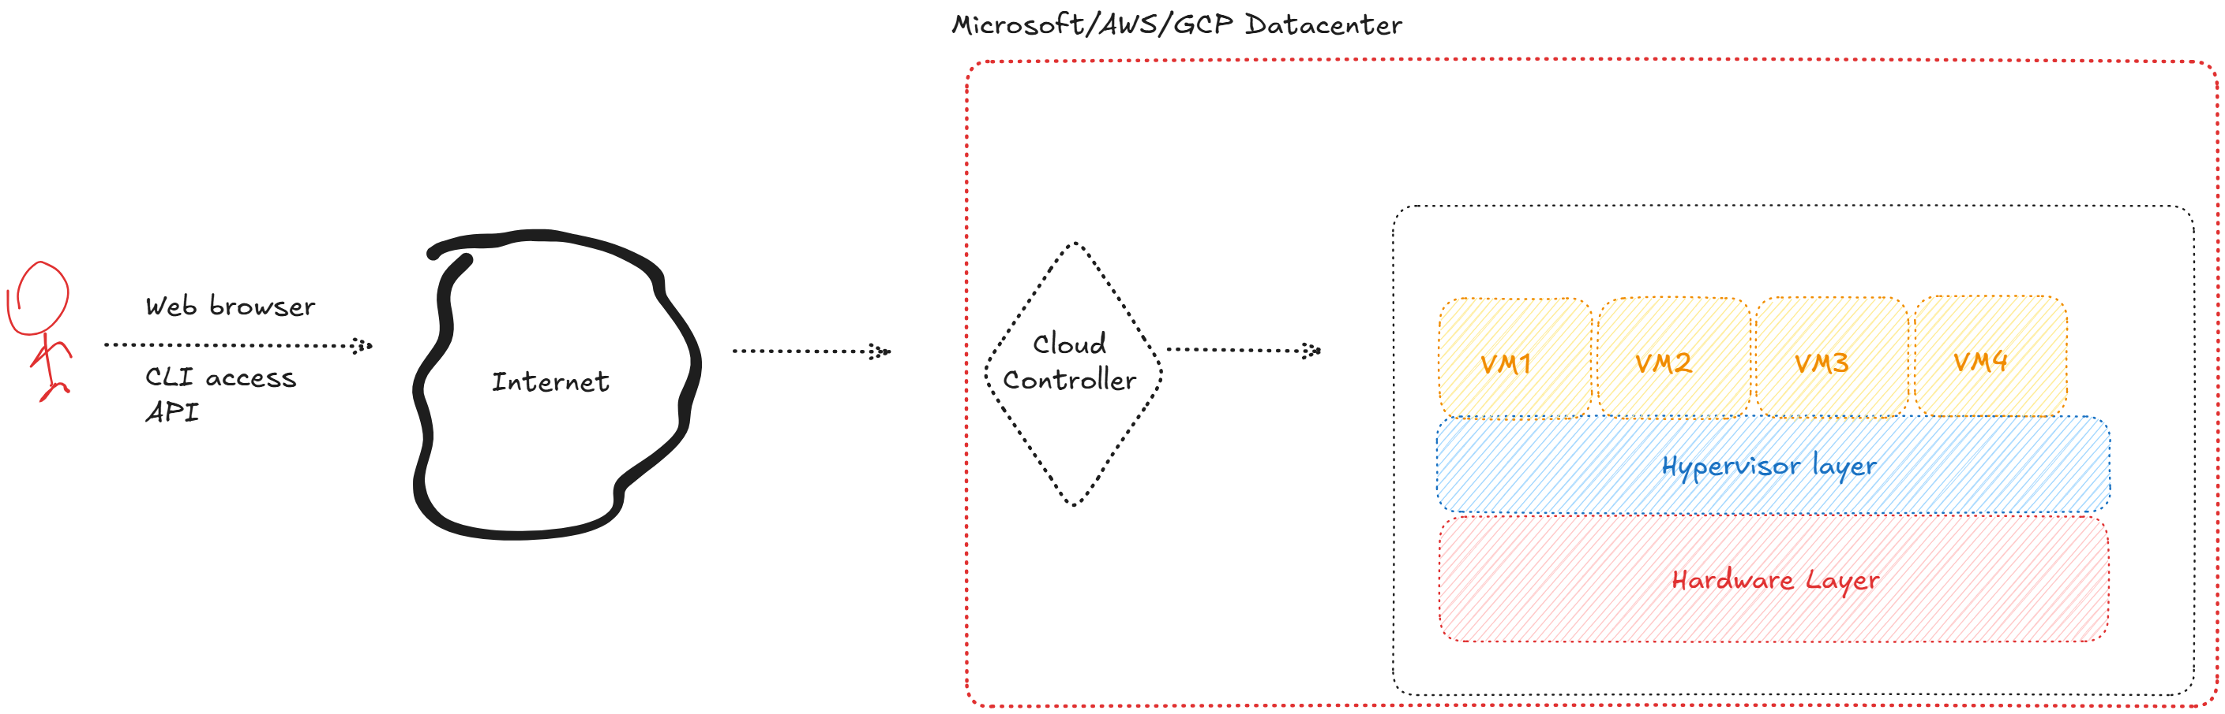
Virtualized DC to Cloud Environment

Slide 11

Why Cloud Computing is a better option?
Highly scalable and flexible
Low-cost solution
Faster and secure
Global Access
Productive
Hybrid
Intelligent

Slide 12
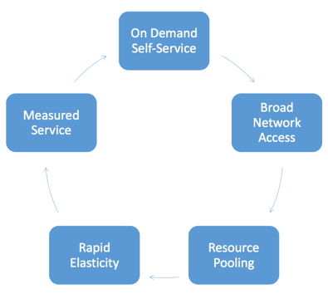
Five Essential Characteristics of Cloud
On-demand self-service
Broad network access
Resource pooling
Rapid elasticity
Measured service

Slide 13
Five Essential Characteristics of Cloud
On-demand self-service
Resources are instantly available when needed.
Broad network access
Access anytime or anywhere a connection to the Internet exists.
Resource pooling
Data center resources are pooled together optimizing quality of service.
Rapid elasticity
The ability to add or remove computing resources based on need.
Measured service
The ability to measure resource usage and charge customers.

Slide 14
Cloud Services
Infrastructure as a Service (IaaS)
Platform as a Service (PaaS)
Software as a Service (SaaS)

Slide 15
Infrastructure as a Service (IaaS)
IaaS is a fully self-service model that delivers infrastructure resources via virtualization technologies.
IaaS comprises scalable computing, storage, and security capabilities accessed on an API or dashboard.
Examples of IaaS
Amazon Web Services (AWS)
HP Cloud Services
Microsoft Windows Azure
Rackspace Cloud
IBM Smart Cloud
VMware
GoGrid

Slide 16
Platform as a Service (PaaS)
PAAS provides a framework for developers to create their own applications. Essential, PaaS gives developers an online platform to create and manage software without worrying about maintaining everything else.
Examples of PaaS
Amazon Web Services (AWS)
Microsoft Windows Azure
Google App
IBM SmartCloud Application services
Force.com

Slide 17
Software as a Service (SaaS)
SAAS is the most common cloud deployment model. SaaS refers to applications delivered over the Internet that a third party manages.
In easy words, the user doesn’t have to worry about hosting, downloading, or updating any software. SaaS applications are typically accessed and ran via a Web browser, eliminating the need to download software onto a user’s machines.
Examples of SaaS
Salesforce CRM
Basecamp
Intuit QuickBooks
Constant Contact
NetSuite
Google Docs

Slide 18
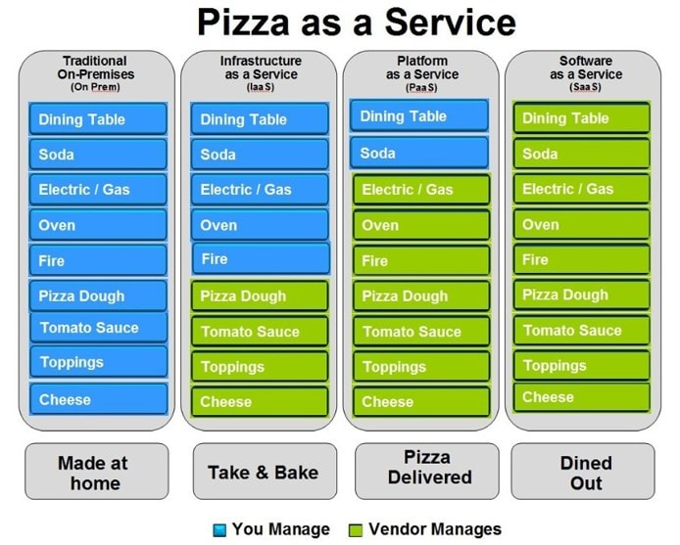
Services provided by Cloud

Slide 19
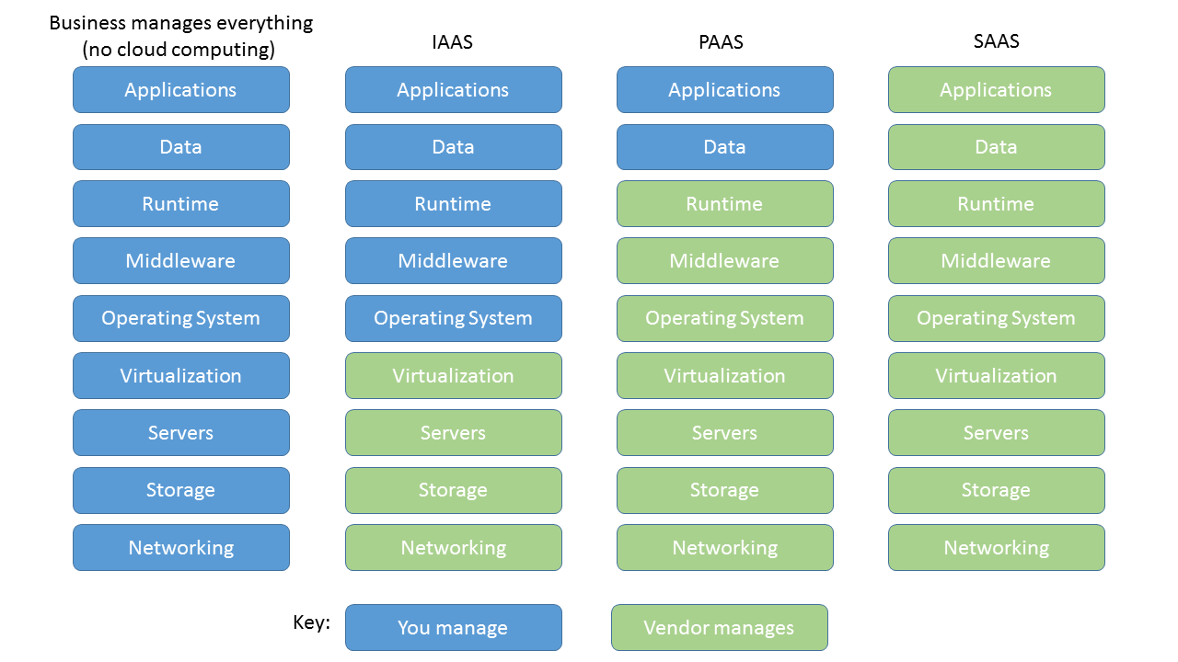
Services provided by Cloud

Slide 20
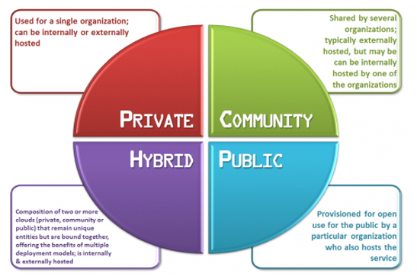
Cloud Deployment Models

Slide 21
Cloud Deployment Models:
Public cloud
You use shared (isolated/without knowing others) resources.
Secure in nature.
Private cloud
You OWN the resources & not sharing with others.
More secure, More costly.
Hybrid cloud
Public cloud + Private cloud
Could be used the scenario where security is bit of a concern.
Private cloud will store: confidential info
Public cloud will be used to share the info among limited people.

Slide 22
Benefits of Cloud computing
Cost
No h/w, s/w, on-prem data centers
Global scale
Elastic in nature (any time scale-in/out).
Performance
Reduced n/w latency.
Speed
Self-service, on-demand, flexibility.
Productivity
No racks & stacks, no h/w setup, no s/w patching.
Reliability
Data backup, easy & cheap DR, redundant.

Slide 23
Why should I move to the cloud?
A nearly limitless pool of raw compute, storage, and networking components.
Speech recognition and other cognitive services that help make your application stand out from the crowd.
Analytics services that enable you to make sense of telemetry data coming back from your software and devices.

Slide 24
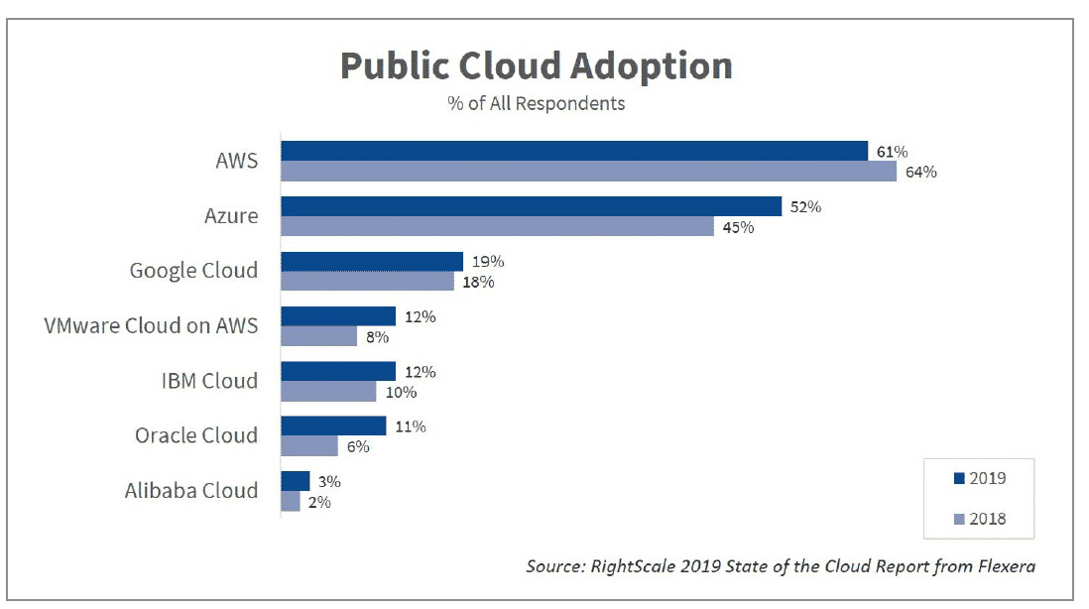
Cloud Adoption - 2019

Slide 25

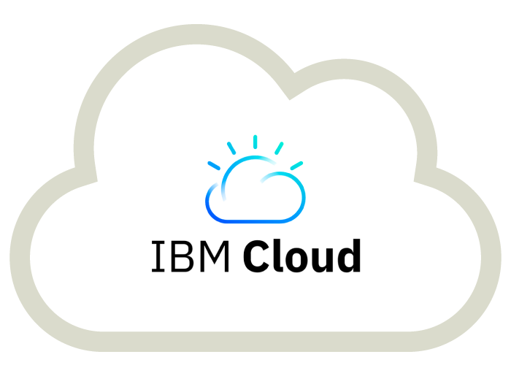
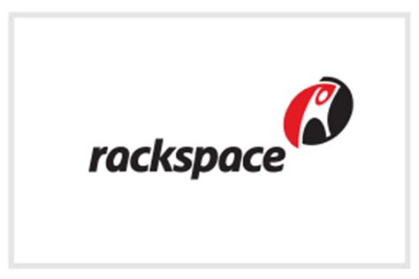

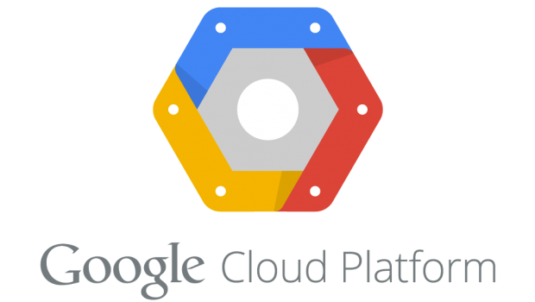
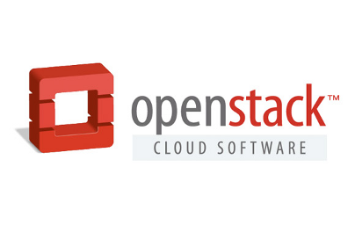
Cloud vendors in market
AWS
Azure
Google Cloud
Alibaba
IBM
VMWare
Rackspace
Adobe

Slide 26
What is Microsoft Azure?
Microsoft Azure is an ever-expanding set of cloud services to help your organization meet your business challenges.
It’s the freedom to build, manage, and deploy applications on a massive, global network using your favorite tools and frameworks.
Microsoft Azure (formerly Windows Azure) is a cloud computing service created by Microsoft for building, testing, deploying, and managing applications and services through Microsoft-managed data centers.

Slide 27
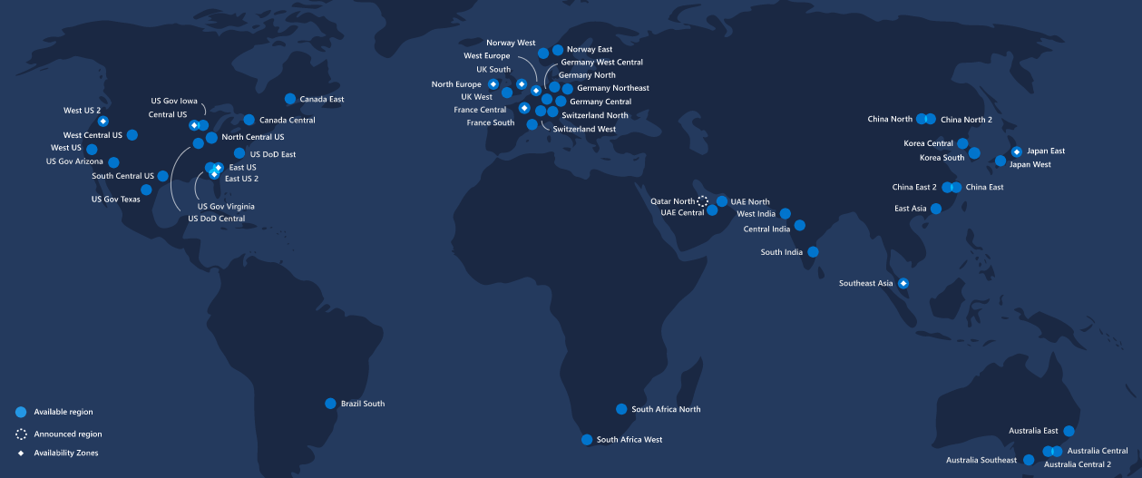
Global footprint - Azure regions
55 regions worldwide available in 140 countries

Slide 28
Tools for Accessing Azure
GUI – New (ARM – Azure Resource Manager)
GUI – Old (ASM – Azure Service Manager{deprecated})
PowerShell
Azure cloud shell (Shell service on Azure cloud)
REST API
Terraform (Azure, AWS, GCP, Oracle…)
ARM Templates (only for Azure).

Slide 29
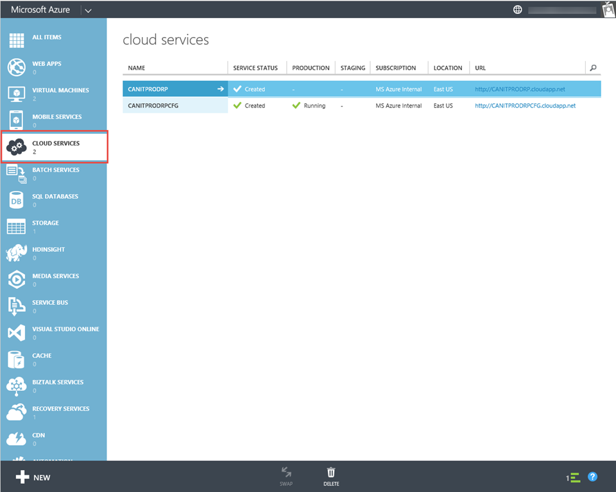
Old Portal – Azure Service Manager (ASM)

Slide 30
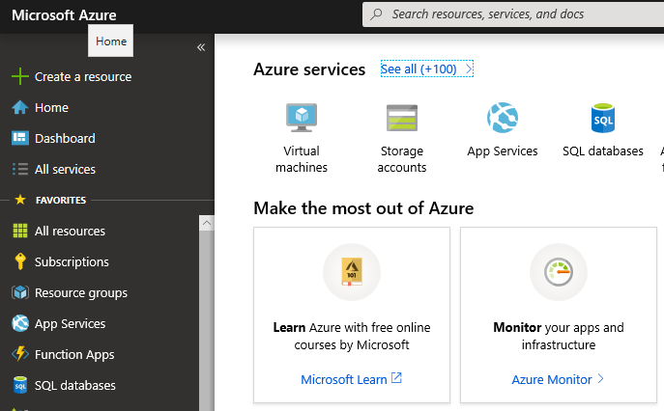
New Portal – Azure Resource Manager (ARM)

Slide 31
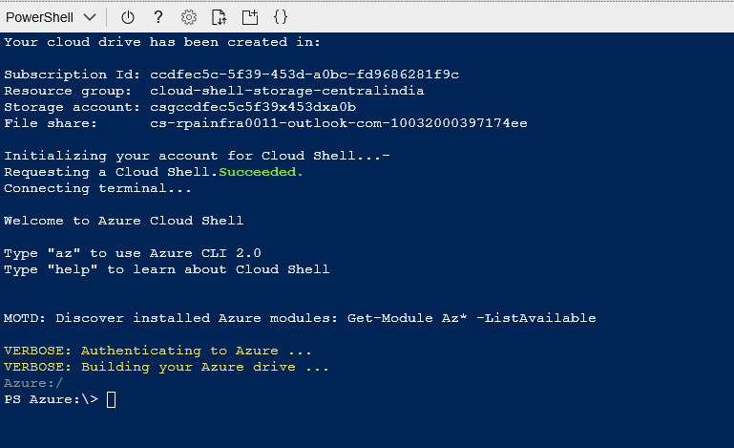
Accessing azure (Cloud Shell)

Slide 32
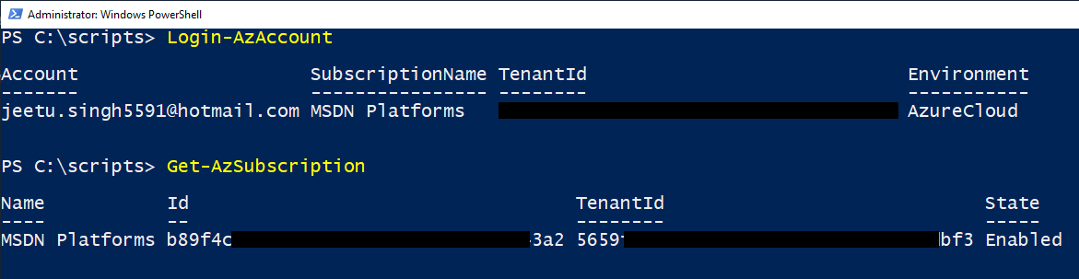
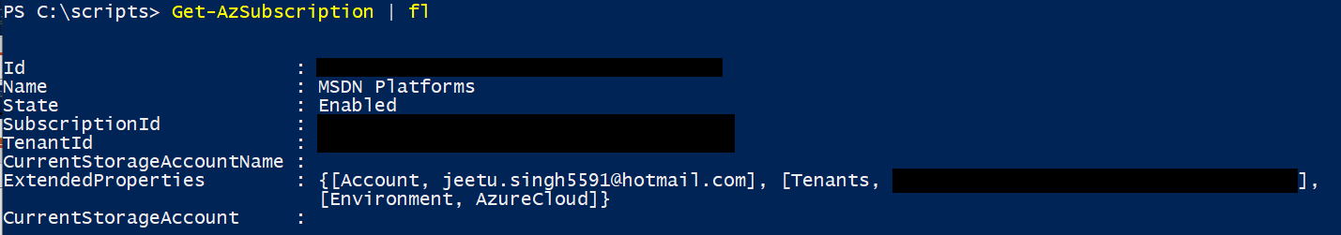
Accessing azure (PowerShell)

Slide 33
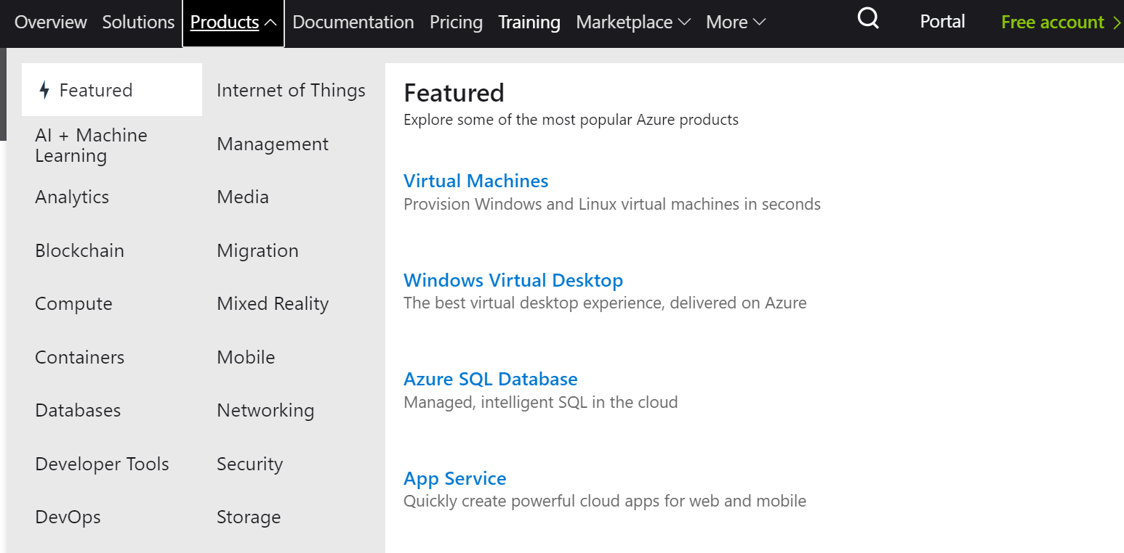
Azure services

Slide 34
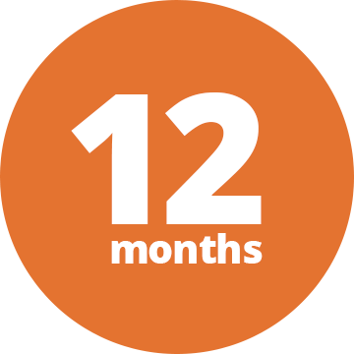
Free services (for 12 months)
Linux Virtual Machines (750Hrs) | Windows Virtual Machines (750Hrs)
Managed Disks (64 GB x 2) | Blob Storage (5 GB)
File Storage (5 GB) | SQL Database (250 GB)
Azure Cosmos DB (5 GB) | Bandwidth (Data Transfer) (15 GB)
Computer Vision (AI + MACHINE LEARNING/5,000 transactions) | Personalizer (AI + MACHINE LEARNING / 50,000 transactions)
Translator Text (AI + MACHINE LEARNING / 2,000,000 characters) | Anomaly Detector (AI + MACHINE LEARNING / 20,000 transactions)
Form Recognizer (AI + MACHINE LEARNING / 500 pages) | QnA Maker (AI + MACHINE LEARNING / 3 days)

Slide 35

Products that are always free
App Service (10)
Functions (1,000,000 requests per month)
Event Grid (INTEGRATION, 100,000)
Azure Kubernetes Service (AKS)
DevTest Labs
Active Directory B2C (50,000, authentications per month)

Slide 36
Azure Subscriptions
Free Trial
Pay-As-You-Go
12-Months-Plan (Prepaid)
Developer Support (MSDN)
Professional Direct Support
Standard Support
Enterprise

Slide 37
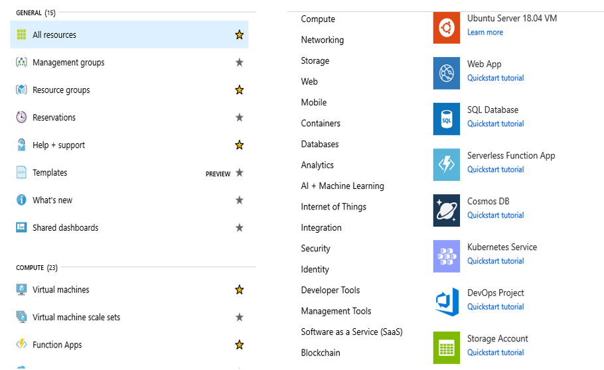
What can be deployed to Azure?

Slide 38
Requirements to run an environment
Similar to an on-premises data center, Azure also have some requirements to run an environment.
Few of them are as follows:
VNet
Storage
Specific port rules (3389,22)
Resource Group
DNS
Etc..

Slide 39
SLA for azure resources
Virtual Machines
99.9% SLA for Single instance
99.99% SLA for VMs deployed in same Azure region. (AS)
Storage Durability
Read: 99.9% (LRS, ZRS, GRS)
Write: 99.9% (LRS, ZRS, GRS) ,RA-GRS : 99.99%
App service
99.95% for customer subscription, No SLA is provided for Apps under either the Free or Shared tiers.
Azure Active Directory
99.9% availability of the Azure Active Directory Basic and Premium services

Slide 40

Migrate on-premises machines to Azure
Supported setup:
VMware VMs.
Physical servers.
Hyper-V VMs.

Slide 41
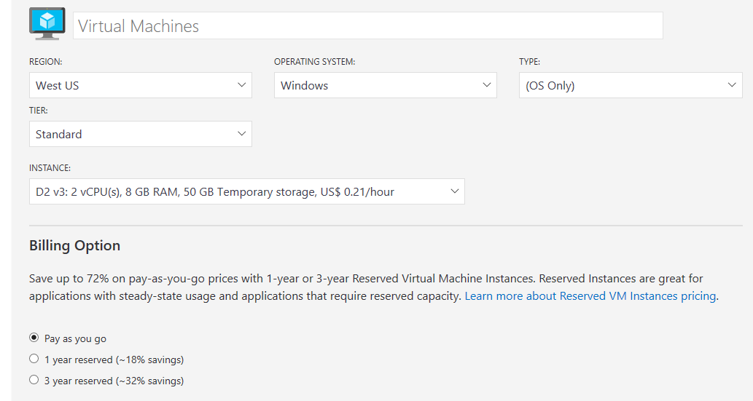
Azure calculator

Slide 42
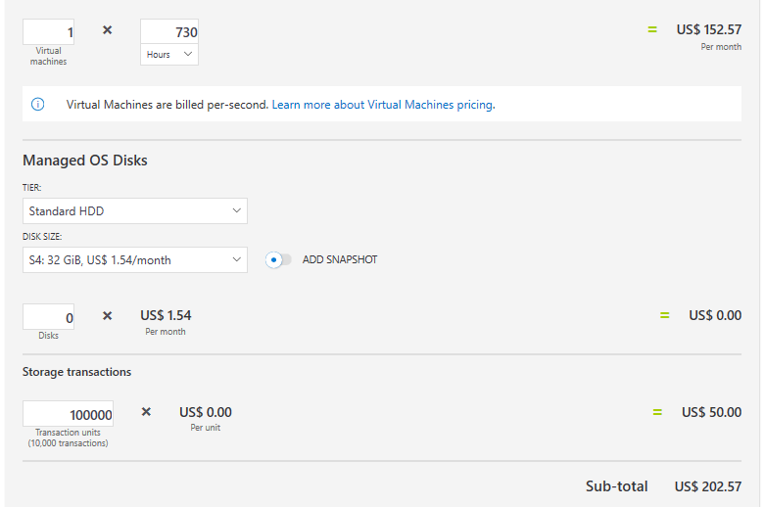
Azure calculator

Slide 43
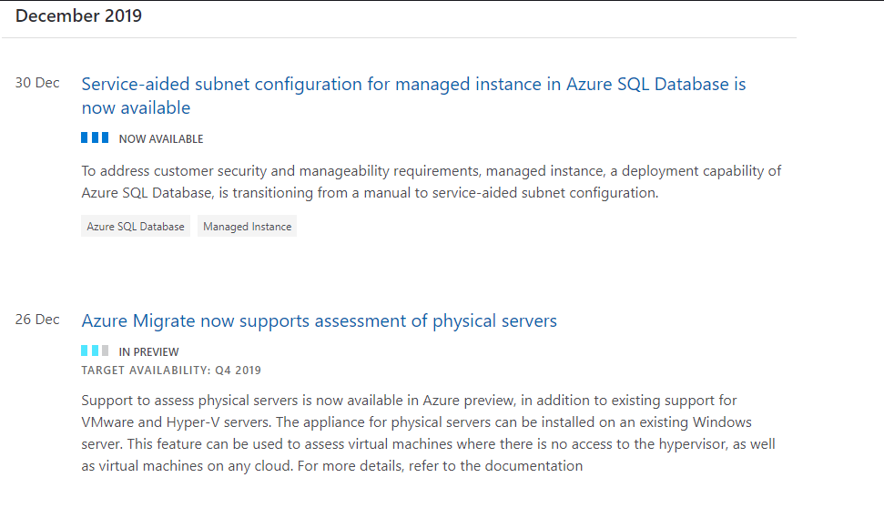
Azure Updates

Slide 44
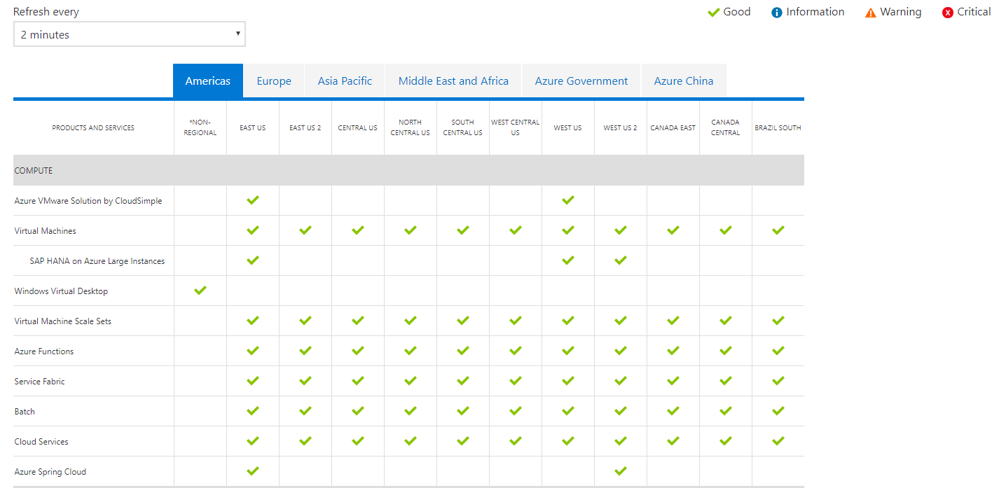
Azure Status

Slide 45
Useful Links
FastTrack updates: https://azure.microsoft.com/en-in/updates/fasttrack-for-azure/
Updates: https://azure.microsoft.com/en-in/blog/topics/updates/
Status: https://azure.microsoft.com/en-us/status/
Pricing calculator: https://azure.microsoft.com/en-in/pricing/calculator/
EDX: https://www.edx.org/learn/azure
YouTube Azure Friday: https://www.youtube.com/playlist?list=PLLasX02E8BPDT2Z2pdCHNCkENpcQWy5n6
Azure Friday: https://channel9.msdn.com/Shows/Azure-Friday

Slide 46


